Slide 1
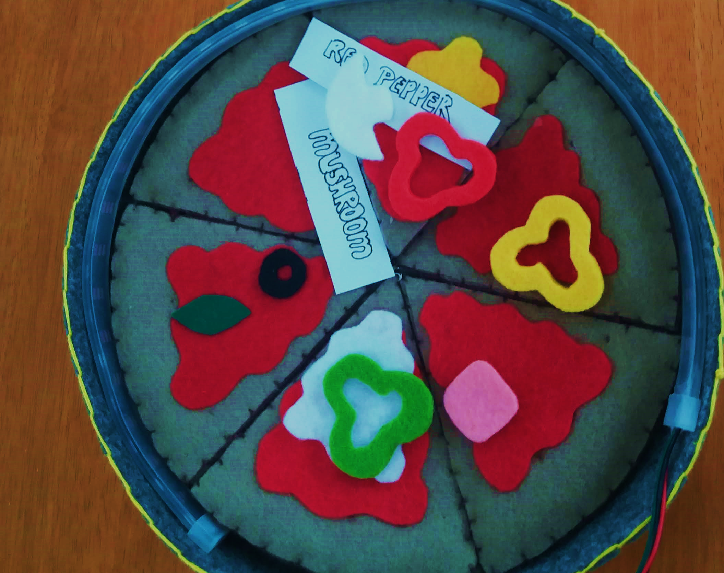
PizzaBox Project
Viva Presentation – Dervla O’Brien

Slide 2
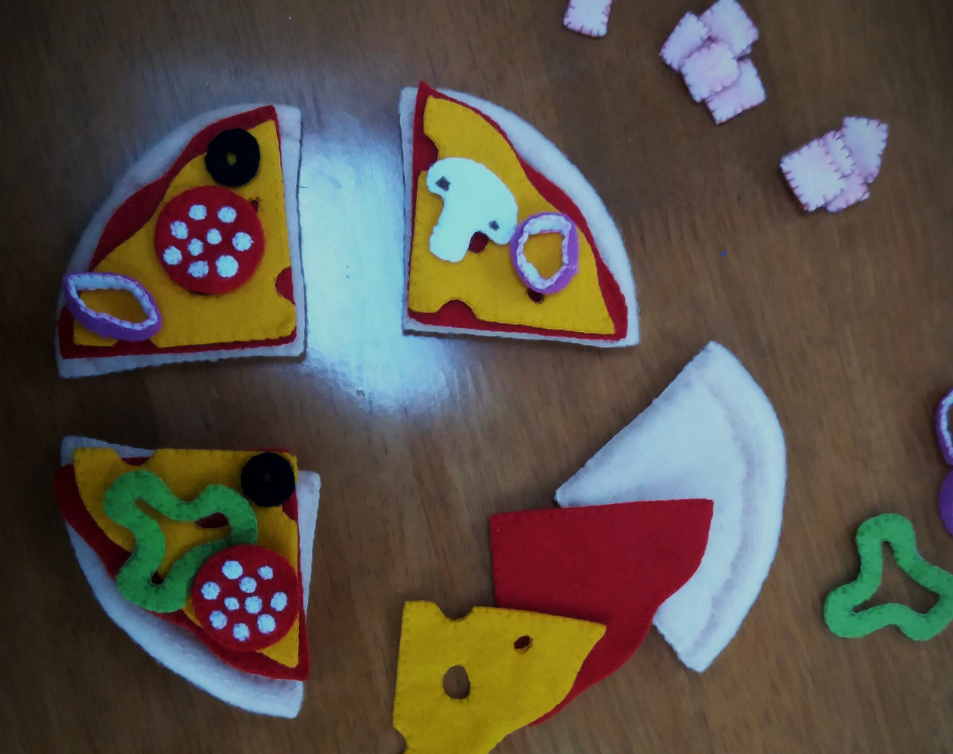
Project Aim
The aim of this project was to extend and improve on work done by a previous student into the area of ordering food by using interaction with the internet of things.
This project was developed for the use case of educating children to better understand nutrition.

Slide 3
Abstract (from report)
Children worldwide have poor diets and poor understanding of nutrition, confining food into dichotomous “healthy” and “not-healthy” groups, rather than grasping deeper, more realistic concepts of variety and balance.
This paper explores how an interactive food ordering system could be designed to help enable children learn to make healthier dietary choices for themselves.
The paper extends a previous study on the PizzaBox system and explores how it can be applied to an audience of 9-11 year old children, with the additional aim of being an innovative and engaging way to educate in nutrition and dietary choices.
Several designs are explored and discussed, and a final design is produced, incorporating the advice of a community dietitian.
Further research should extend the functionality, perhaps with a focus on how this project could be used within a program of education in schools.
It would be beneficial to measure how effective this intervention is at changing dietary habits and educating its users.

Slide 4
Background
This project intersected across a number of main areas of study:
1. Nutritional Awareness and Education
Prevalence and severity of obesity
Education as a right and a intervention to health problems
Which age group of children would be most effective to target?
How could this system address the pre-existing healthy eating curriculum for this age group?
The importance of allowing children to choose healthy eating, rather than forcing it upon them.

Slide 5
Background
This project intersected across a number of main areas of study:
2. Human-Food Interaction – how humans interact with food and food environments
The rising popularity of online ordering
Useful examples of technology at mealtimes
Designing fun and playful food products
Research into Food labelling

Slide 6
Background
This project intersected across a number of main areas of study:
3. Internet Of Things for Children and Tangible Objects
What is IOT?
How IOT has been used in similar tangible objects
What are E-textiles and how can they be used for educational projects?
Problems using IOT with children, such as privacy, cost, understanding of risks and how effective they are for teaching

Slide 7
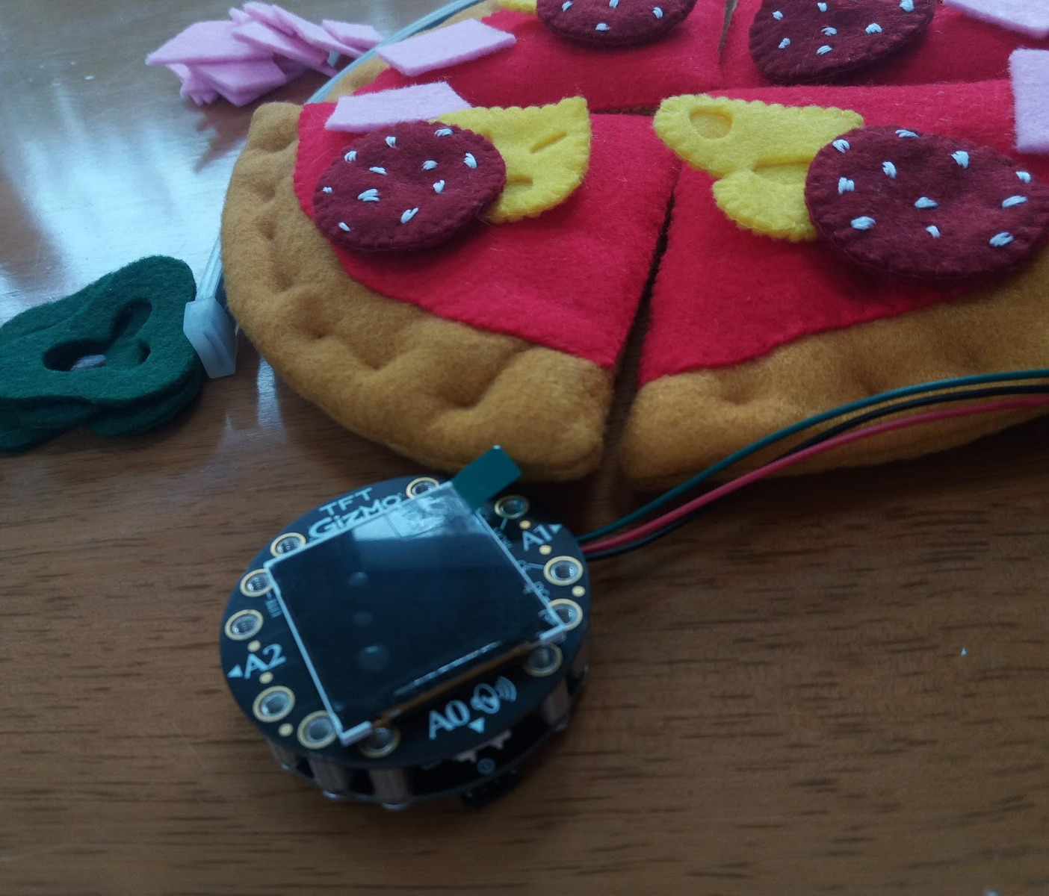
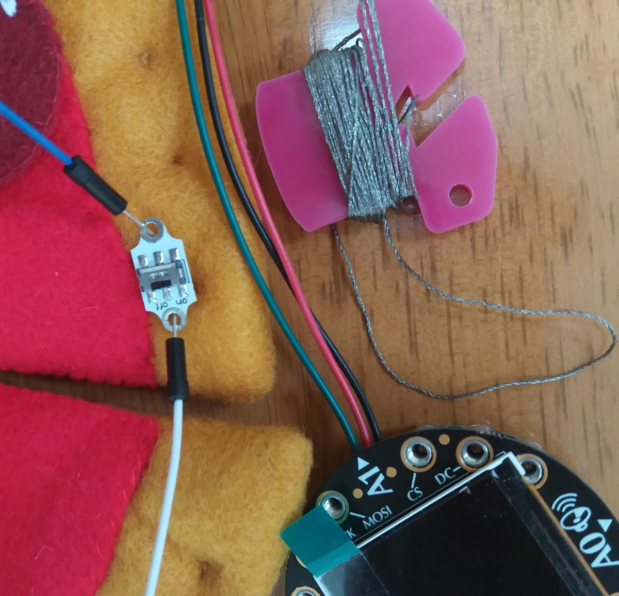
Methodology
Originally planned to co-design the system in a classroom. By the time this was due to commence the coronavirus outbreak meant that my plans had to be changed.
Interview with community dietician about children’s nutrition and their educational awareness
Developed low-fidelity designs to explore ideas for features
Completed a task analysis of the Domino’s online ordering process
Implemented medium-fidelity prototypes and adapted the designs to solve the hardware and software problems I encountered.
Gained feedback from the dietician on parts of the medium-fidelity designs.
Created the final high-fidelity prototype.

Slide 8
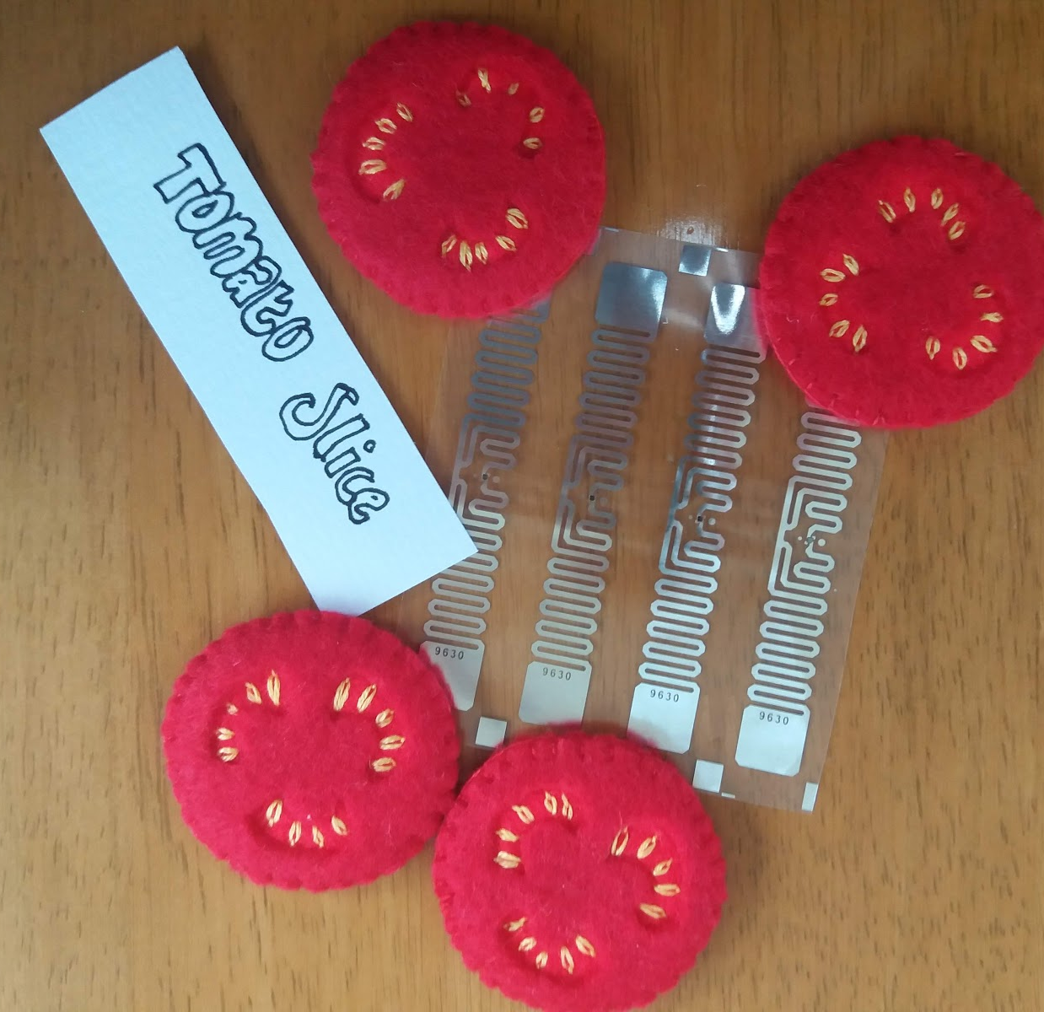
Design Aims
Promote healthy eating, in line with guidance from professionals
Educate users – Give a better understanding of key nutritional points
Empower users to make their own choices – By encouraging the users to make healthier choices within the system, they may be able to extend this practise further into the outside world and their everyday diets.

Slide 9
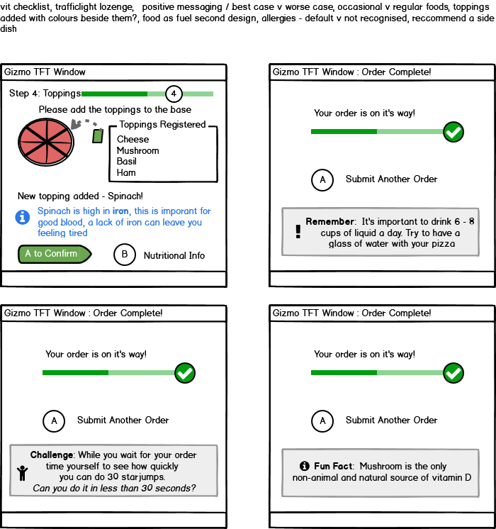
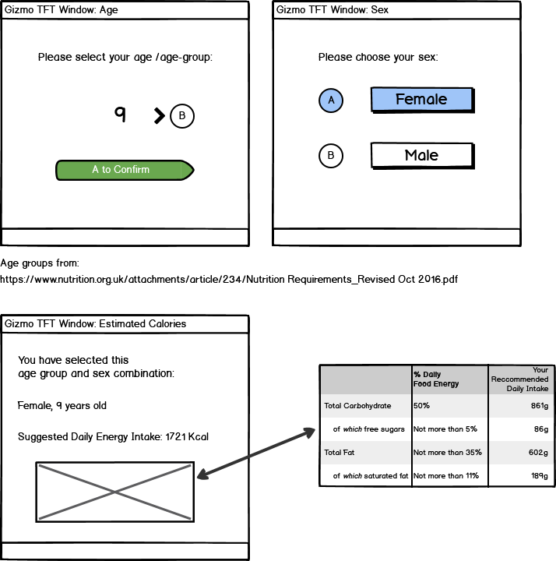
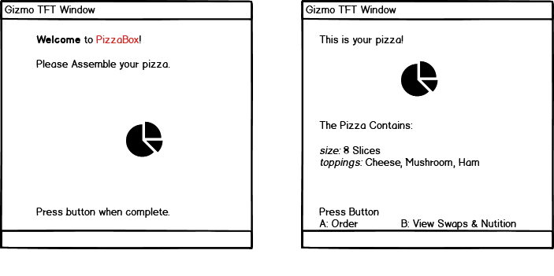
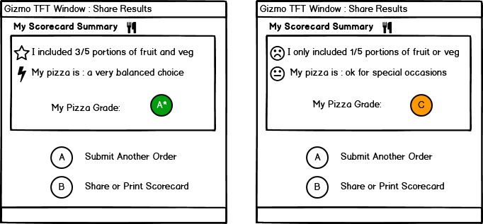
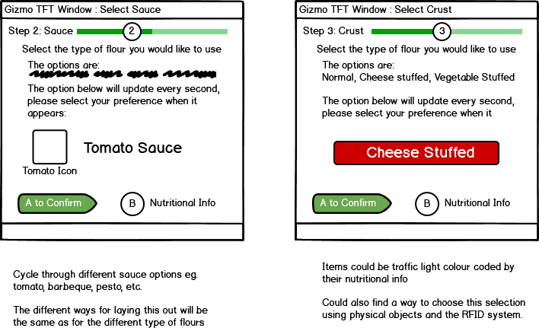
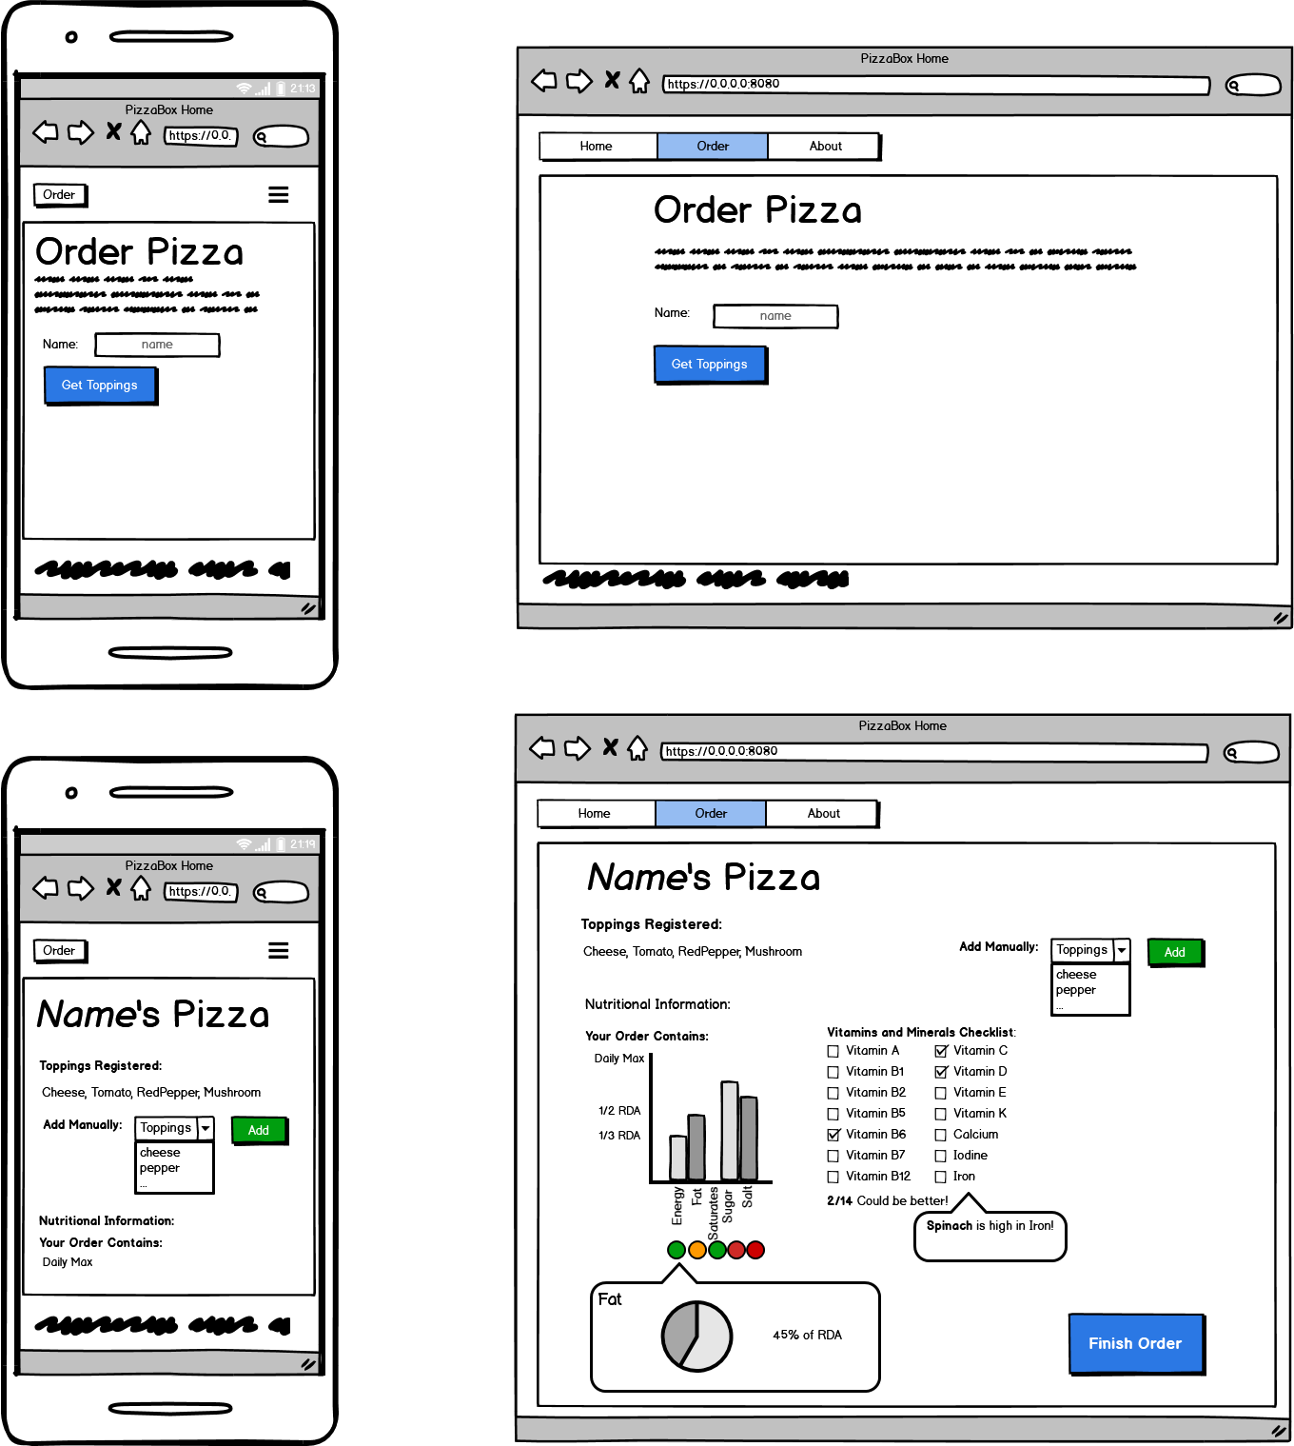
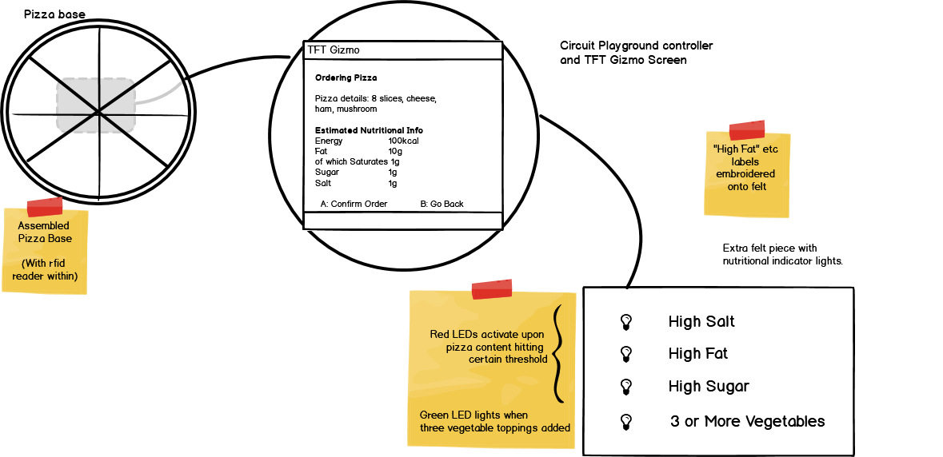
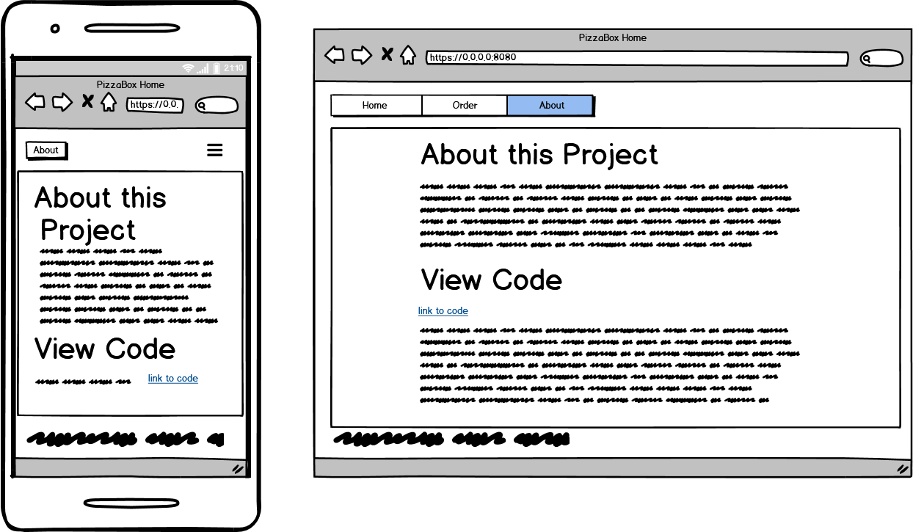
Sample Designs
2. As I continued to make more designs the features became more complex.
1. I created some simple designs of the features and ideas I had in mind.
3. After encountering hardware issues during the medium fidelity prototyping,
I redesigned the display for use with laptops and mobile devices.
I tried to include a design for each point the dietician highlighted in my interview with her.
For example: she discussed portions being too big, so I looked at how the user would control and receive prompts around portion size.

Slide 10
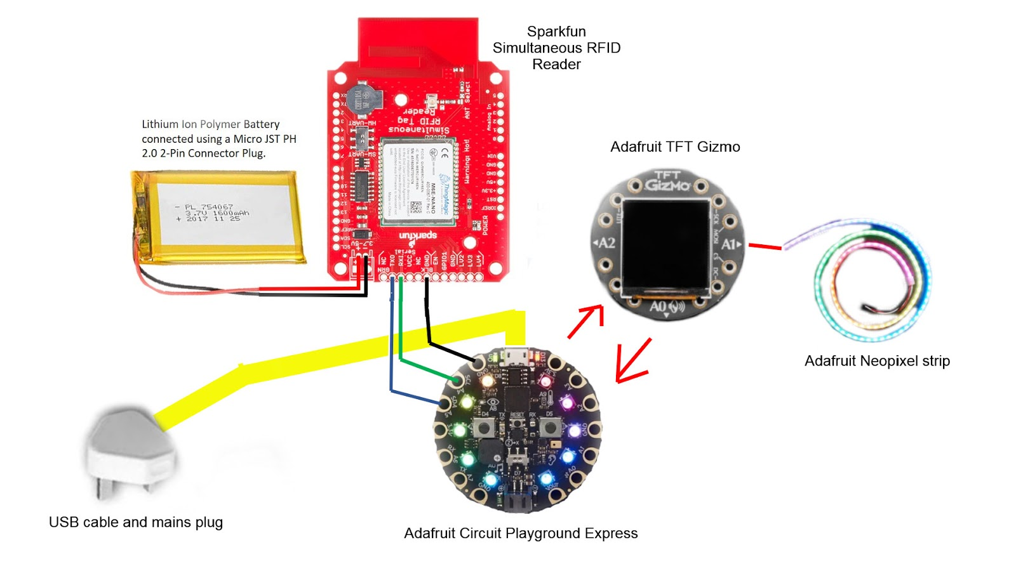
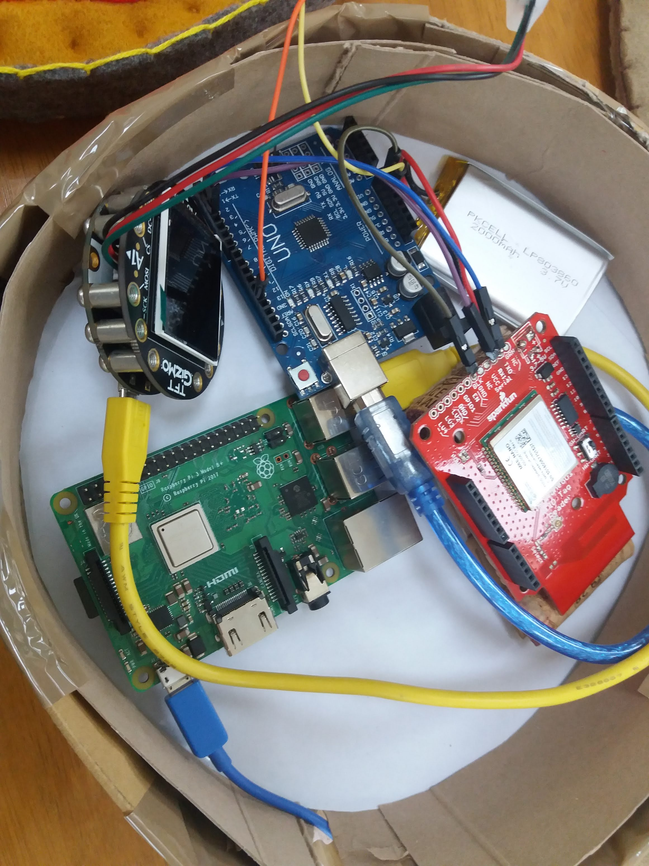
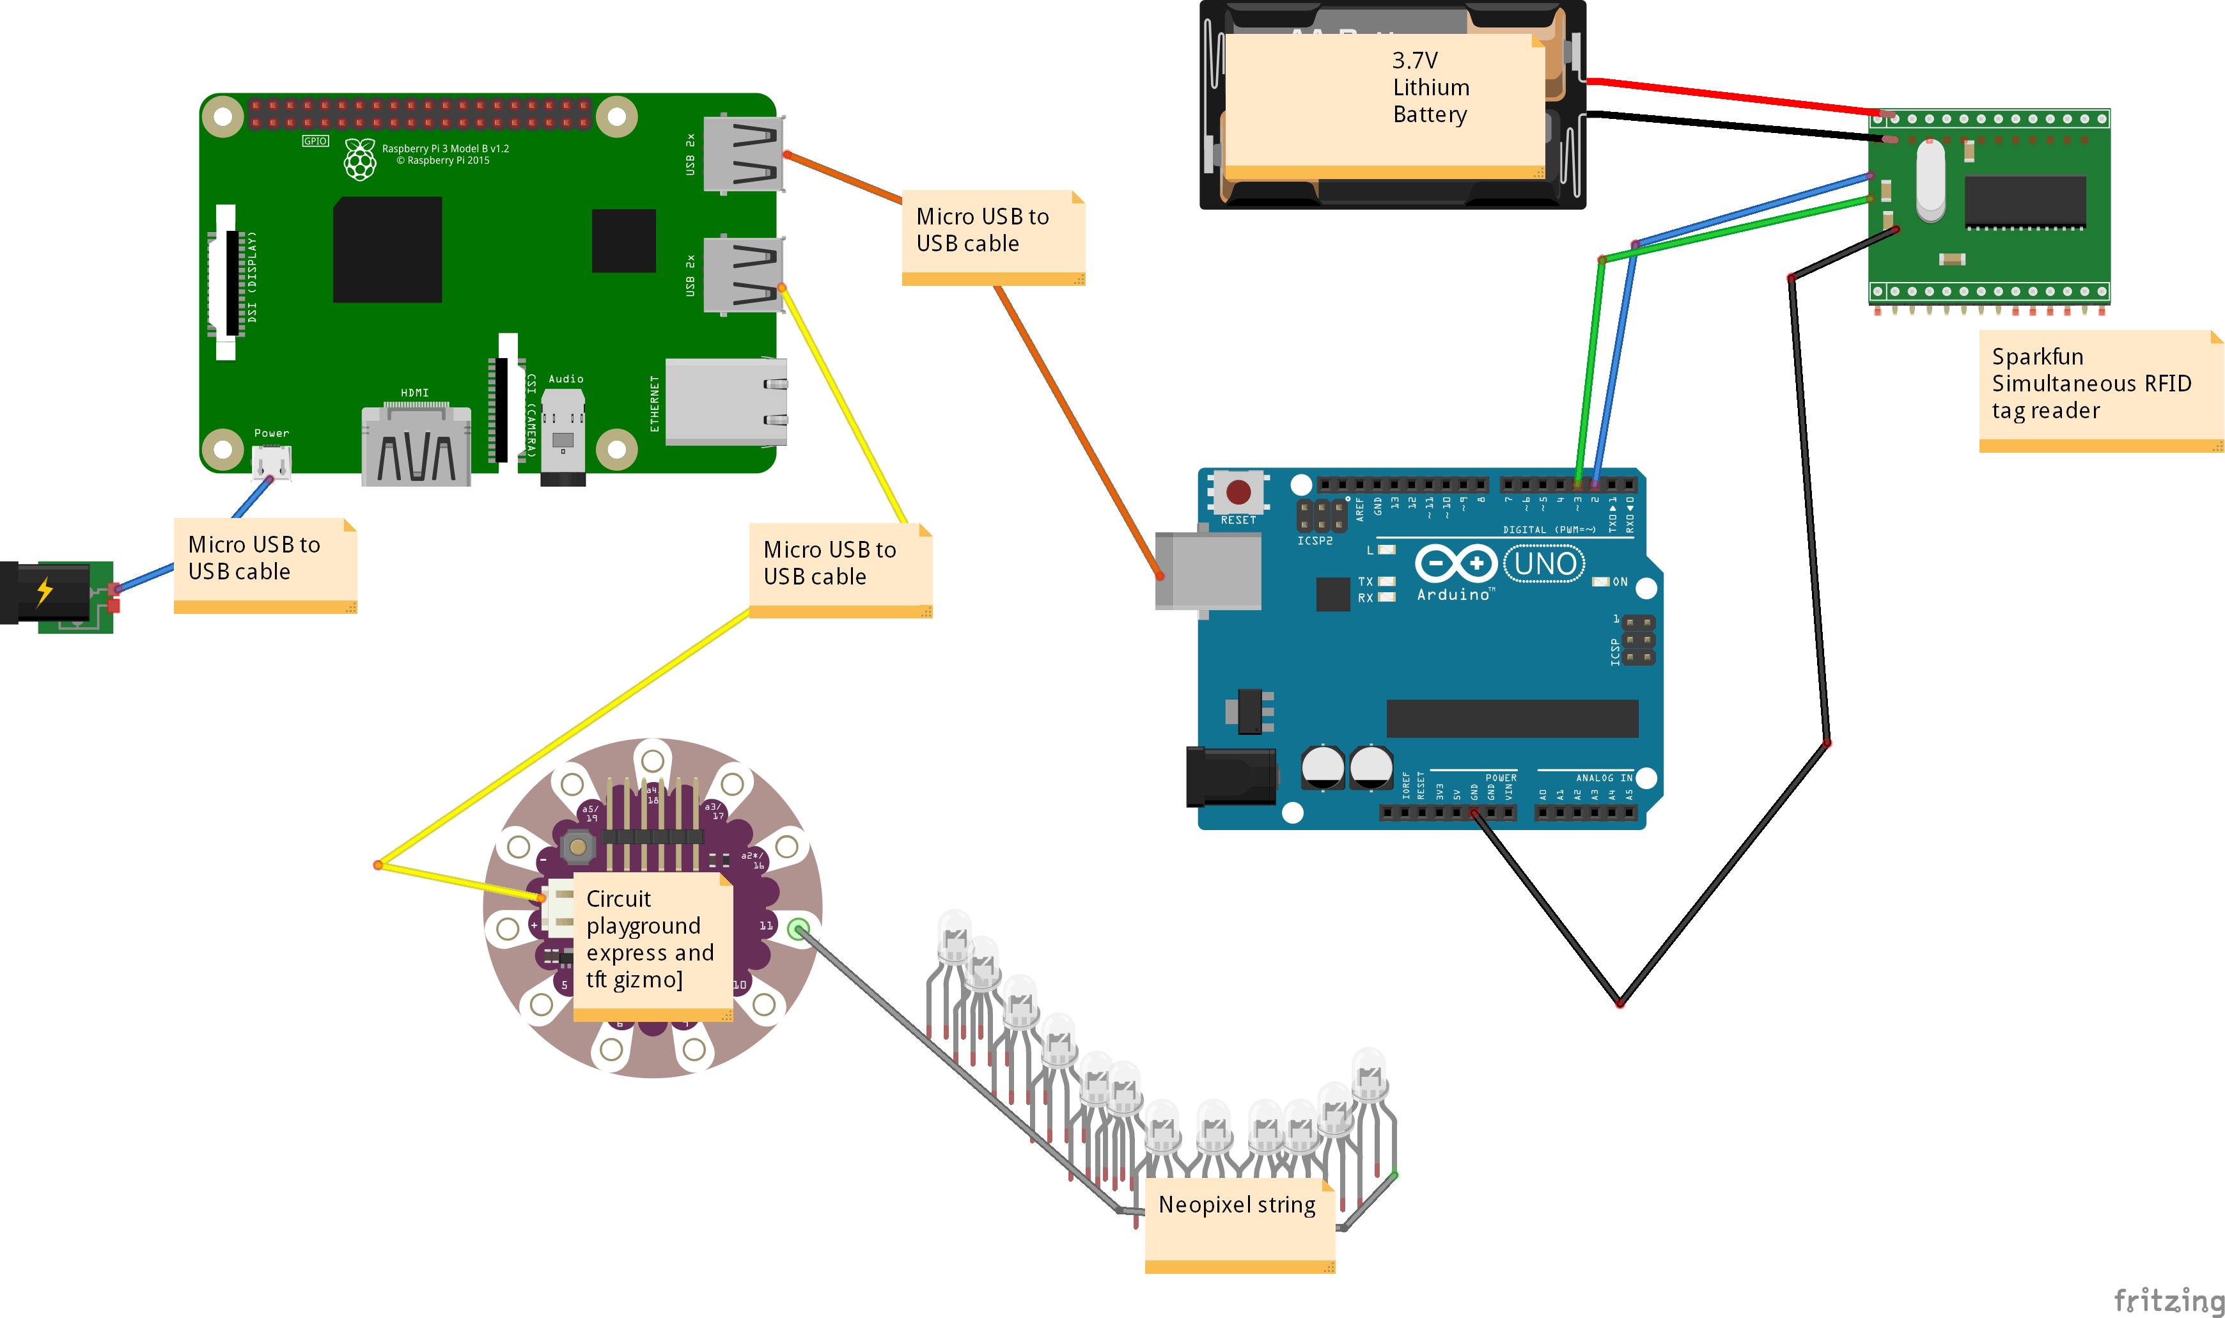
Hardware Designs
During the medium-fidelity design stage I began to look at how hardware components would interact.
One component was defective, and the micro-controller didn’t include wi-fi functionality, so I realised there were problems with the initial design.
Using all the components I had to hand I adapted my solution to create a second design.

Slide 11
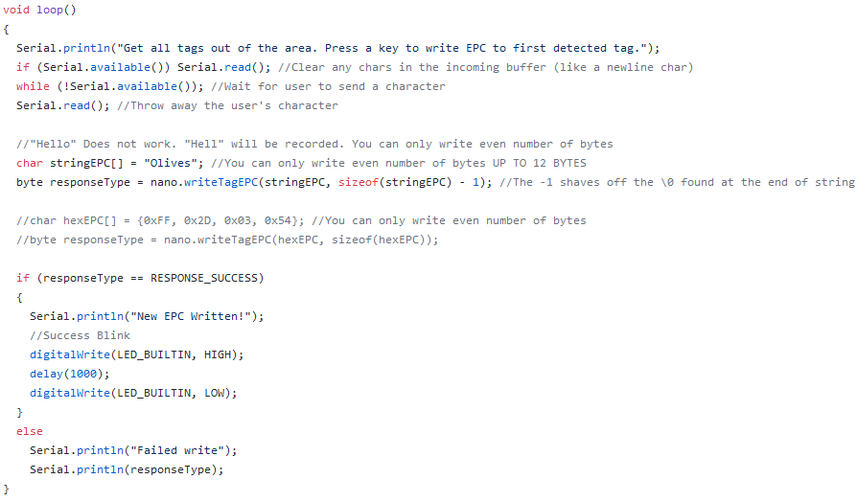
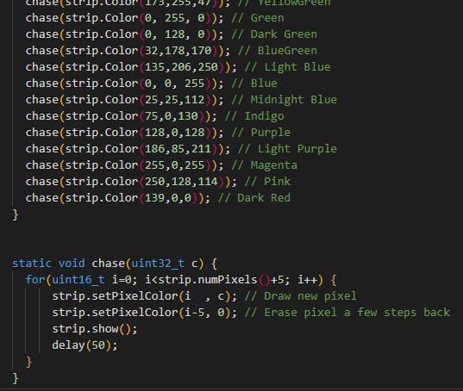
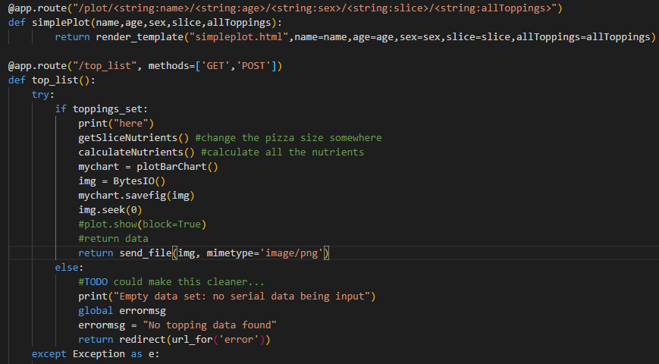
Code
System code is distributed between the Arduino Uno, the Circuit Playground Express & the Raspberry Pi micro-controllers.
Arduino: Powers RFID module and receives serial information about what UHF tags are nearby. Sends this information about the tags (or the pizza toppings) to the raspberry pi using the serial port. Written in C++
Arduino was also used to write information to all tags initially
Circuit Playground Express: Powers NEOpixel Lights and displays a rainbow throughout. Also plays a short melody on power on. Written in C++
Raspberry Pi:
Receives and decodes (using Codecs library) serial data from Arduino, finding the key information using RegEx.
Uses serial data input about nearby tags to update a running total of toppings in a constant background thread.
Pi also runs a Flask website, styled with Bootstrap 4, which can be accessed by any device on the local network. Written in Python, HTML and CSS.
Uses the Pandas library to import nutritional information about toppings from a CSV file into a data frame, update nutritional information and then uses MatPlotLib to plot this information as a simple bar chart.
Notes:
Codecs- Coder / Decoder

Slide 12
Limitations & Problems Overcome
Ran into several initial difficulties organising paperwork, risk assessments and ethics approval for initial primary school co-design methodology.
Had to adapt and change methodology once classroom interaction was not possible.
GizmoTFT screen was defective
Initial iterative designs assumed IOT connectivity for circuit playground express. At a more detailed stage of design I realised this assumption was incorrect.
The above points, and the fact that I could not rely on ordering new components due to Covid-19 related shipping delays, led to drastic redesign.
The hardware design uses more components than necessary in order to accomplish my aims, instead of three microcontrollers, only one should be necessary.
Materials limitations also meant it took more time to make basic functionality work, because several components had to communicate, thus cutting into development time.
Led to the development of a website design, instead of coding a screen component based display.
Also had issues finding reliable nutrition databases for the nutritional display, so had to fill in some numbers with dummy values.
Notes:
Hurdles.. V positive about final outcome highlight problems and then mitigations or solutions & show how you engineered around
No access to other hardware

Slide 13
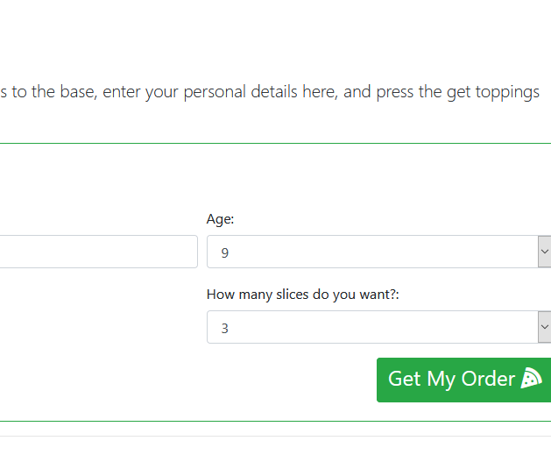
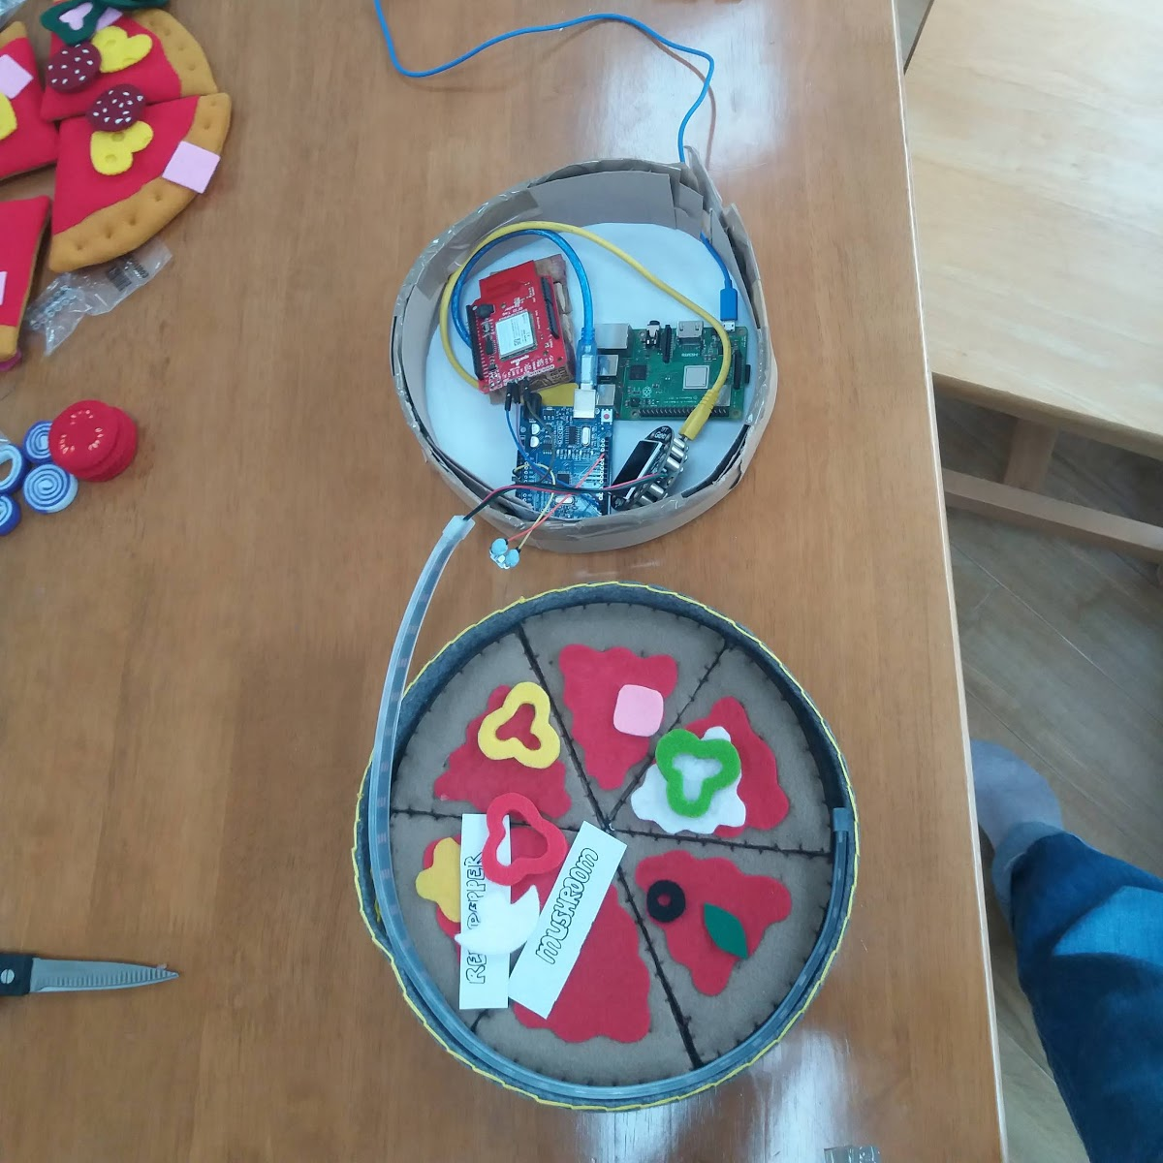
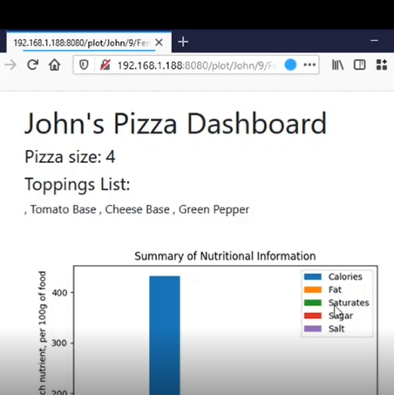
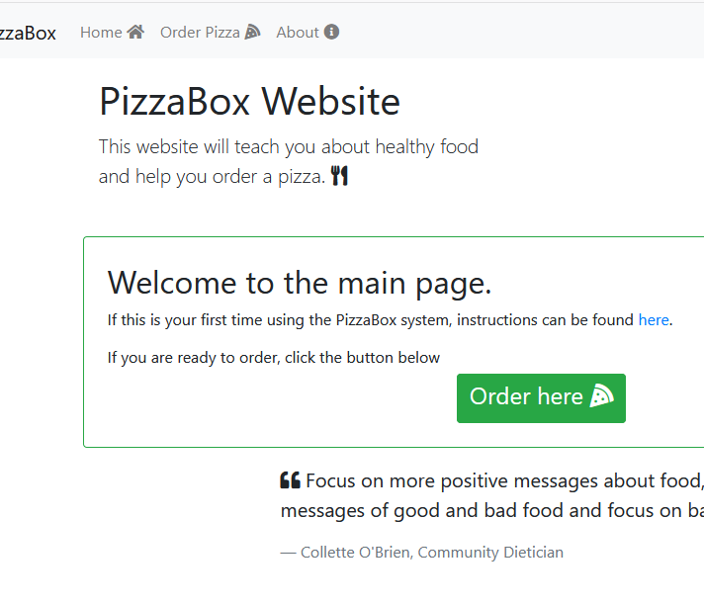
Final Product
Tactile and engaging pizza tangible object, with hidden hardware
Fully mobile-responsive bootstrap website hosted on Raspberry Pi using Flask
Successful interaction of micro-controllers (Arduino, raspberry pi and to some extent the circuit playground express)
Use of RFID for recognising toppings.
Shows a proof-of-concept for how this project can be extended towards this specific use-case.
Report details further designs and lessons plans which a future student can easily utilise for further exploration.

Slide 14
Further Research
In order to see how effectively this project addresses it’s initial aims it requires a human-computer interaction study. Some form of user testing would improve this system so that we could measure its abilities as an educational tool and as a dietary intervention.
Future studies would also benefit from implementing the initial co-design methodology that was intended for this project, obtaining design input from school-children. Adapt for classroom needs such as learning difficulties or language difficulties.
Implement more of the features found in the initial low-fidelity designs and increase the complexity of the functionality of the system.
Possibly obtain feedback from a greater range of dieticians, especially one with speciality in paediatric nutrition.
Notes:
-> Lesson plans for implementation in appendix
-> Accessibility of website

Slide 15
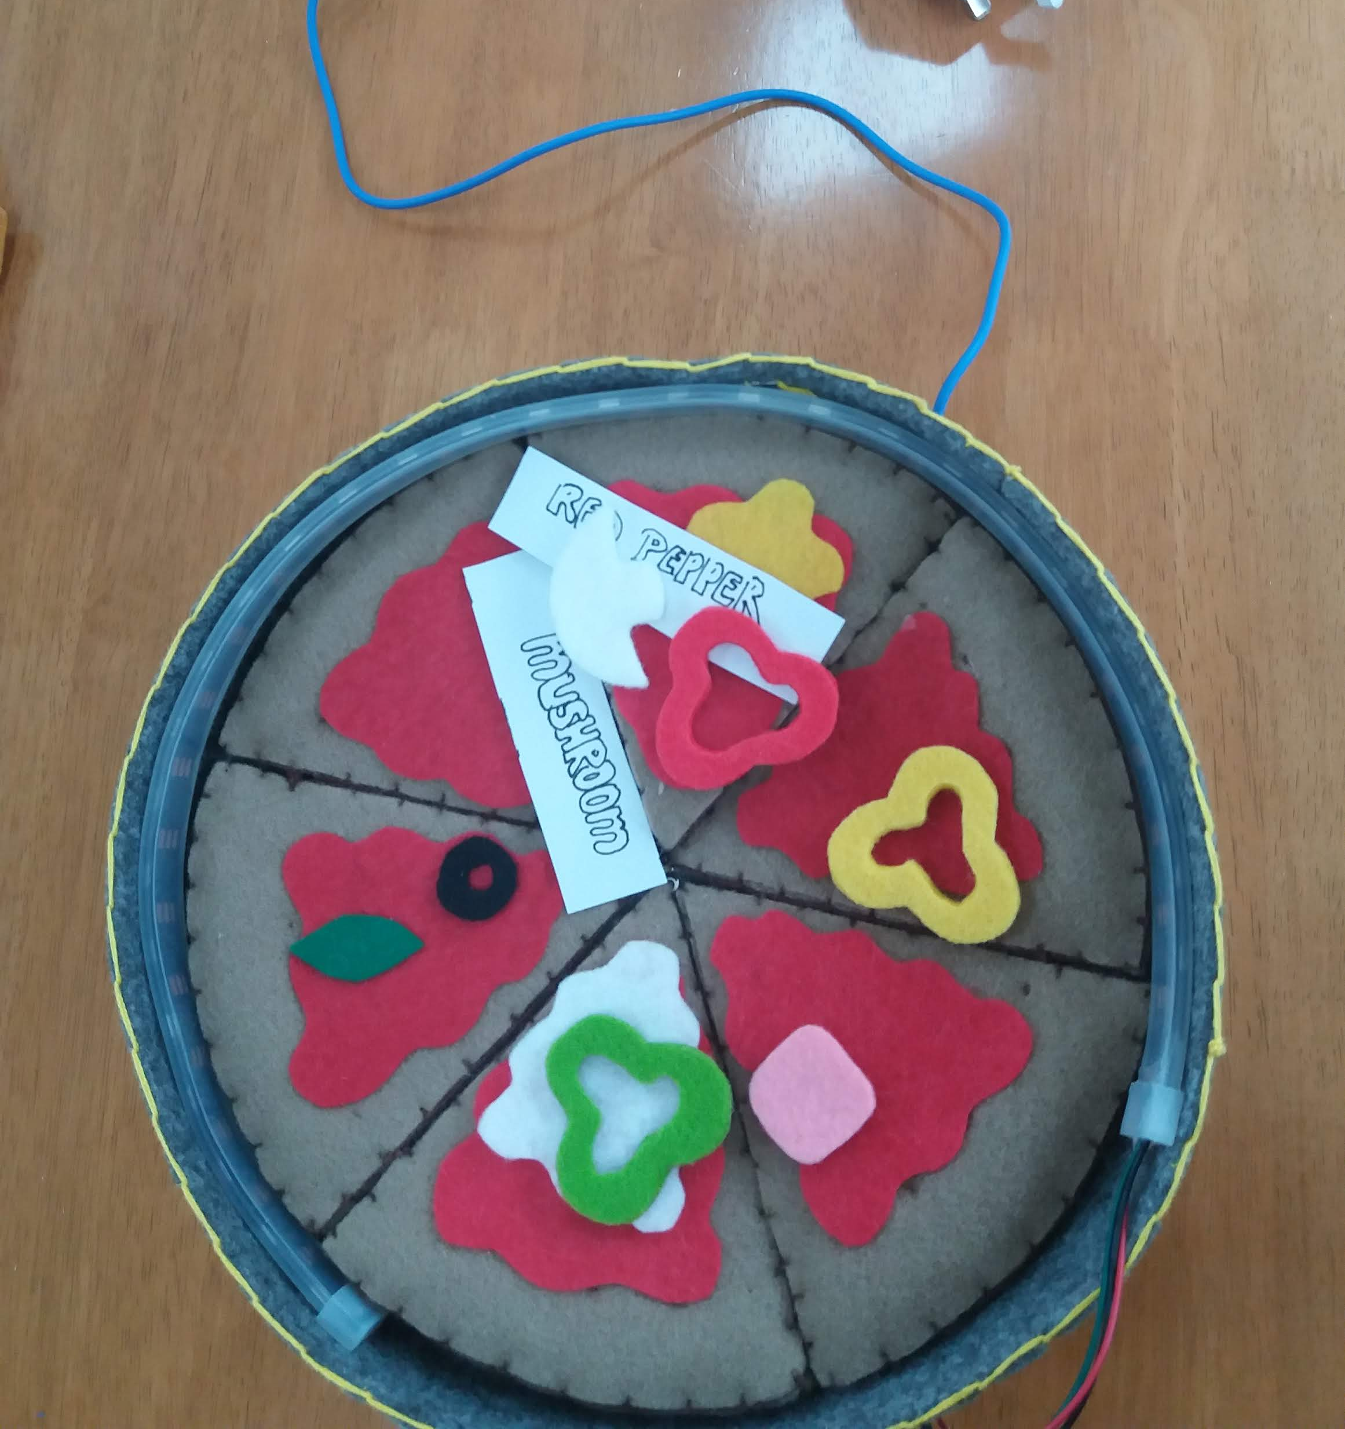
Thank-you for your time. Questions?

